Slide 1
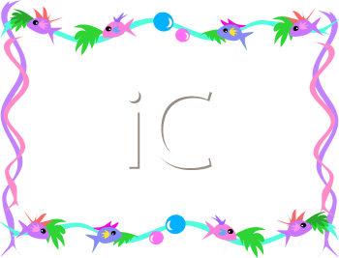
Capture - Recapture
Make a new page in your notebook:
Proportions – Capture Recapture.
Update your TOC.

Slide 2
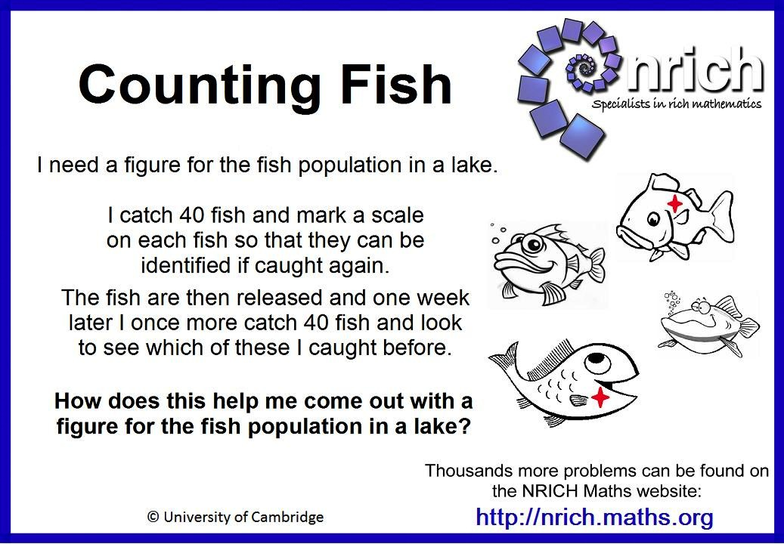
What do you think?
Answer this question in your notebook.

Slide 3
Estimating
Ping Pong Balls!
http://www.youtube.com/watch?v=tyX79mPm2xY
Notes:
Only watch one of the ping pong balls. STOP before the math calculations. Have them calculate, then show them the number.

Slide 4
Capture ReCapture!
Estimate the number of total fish in your habitat.
Estimated number of fish _____________.
Record this!

Slide 5
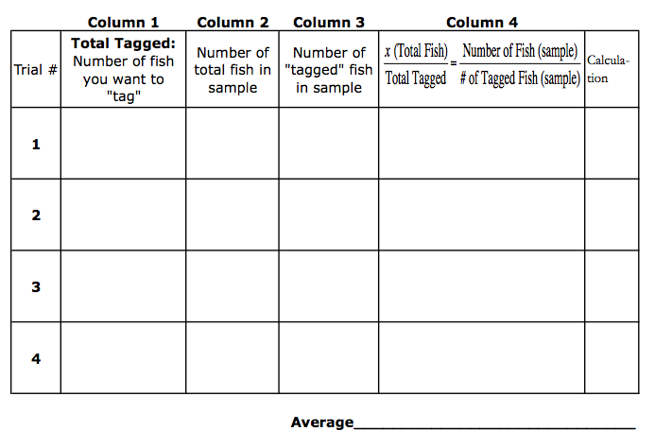
Pick the number of fish that you would like to tag.
Record this number in column 1.

Slide 6
Replace goldfish with tagged fish. Mix around.
Select a sample of goldfish.
Count the total fish in the sample, enter that number into column 2.

Slide 7
Count the number of "tagged" fish,
enter that number into column 3.

Slide 8
Write the proportion in column 4.
Solve the proportion to estimate the number of fish in your pond.

Slide 9
For the most accurate results, repeat the procedure several times and take an AVERAGE.

Slide 10
Results
Group | Original Estimate | Calculated Estimate (average) | Actual Number of Goldfish
Notes:
Here, I entered the group information so every one could see all of the results.

Slide 11
What other things are you interested in estimating by sampling?

